Slide 1
Use of several Cloud Computing Approaches for Climate Modelling:
Performance, Costs and Opportunities
Perez Montes, D. A., Añel, J. A., C. H. Wallom, D., Arribas, A., Uhe, V. Caderno, P., F. Pena, T.

Slide 2
Cloud Computing for Atmospheric Sciences
Most of the current simulations are ran on HPC environments.
Cloud Computing can allow scientists to dynamically (and on-demand) get a high volume of computing resources.
Some experiments are already on the cloud (e.g. UK Met Office).

Slide 3
Possibilities Evaluation: Experiments on Different Providers – AWS vs Azure

Slide 4
Possibilities Evaluation: Experiments on Different Providers – GCE vs FT

Slide 5
Possibilities Evaluation: Experiments on Different Providers – GCE vs FT

Slide 6
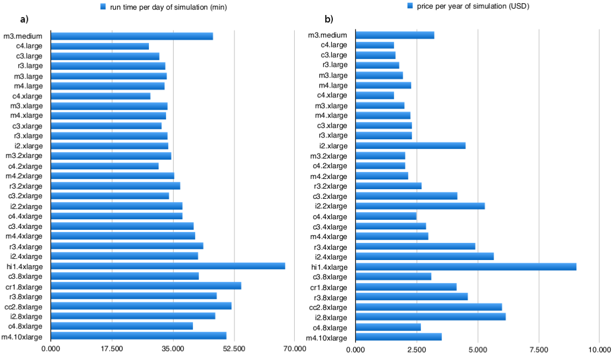
CPDN on the Cloud

Slide 7
CPDN on the Cloud

Slide 8
Funding Research on Cloud Computing
Moving from HPC to Cloud also moves the need to get funding (private providers).
Paying for automated work that on a SuperComputer environment is traditionally done manually (reducing toil for engineers and scientists).
A boost on Cloud Computing is expected over the next years.

Slide 9
Security on the Cloud
Perception that in-house solutions are “safer”.
Cloud providers meet the industry standards and certifications.

Slide 10
Security on the Cloud
For Climate Research it is essential not to have data tampering.
Blockchain technologies are a potential solution.

Slide 11
Conlusions
Experiments are moving towards a IaaS or HPC as a Service.
Cloud costs are high, mixed public-private clouds could be a good option.
Migrations from traditional HPC to Cloud should be carefully studied (costs have a high impact).

Slide 12
References
Montes et al. (2017) Enabling BOINC in infrastructure as a service cloud system, Geosci. Model Dev., doi:10.5194/gmd-10-811-2017
Añel et al. Clouds as a solution. (submitted to Bull. Am. Meteorol. Soc.)

